Slide 1
Spark Architecture

Slide 2
Architecture Overview
Spark Cluster setup – Pseudo distributed mode
Spark Shell
Spark Context

Slide 3
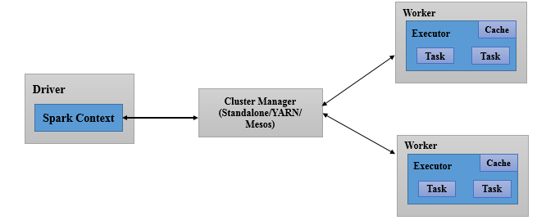
Architecture Overview
Master/Slave architecture with cluster manager and two daemons.
Daemons are:
Master – Master/ Driver Process
Worker – Slave Process

Slide 4
Architecture Overview
A spark cluster has single coordinator called driver and many distributed workers.
Driver communicate with large number of distributed workers called executors.
Cluster Manager is responsible for scheduling and allocating resources to a Spark Job.

Slide 5
Architecture Overview - Role of Driver
The driver program
Entry point of the Spark Shell (Scala, Python, and R).
Runs application main () function
Is the place where Spark Context is created.
Responsible for:
Scheduling job, negotiating with the cluster manager.
Converting a user application into smaller execution units i.e. tasks.
You can access running spark application information through default Web UI at port 4040.
Notes:
https://hostIp:4040
The Web UI is application specific.

Slide 6
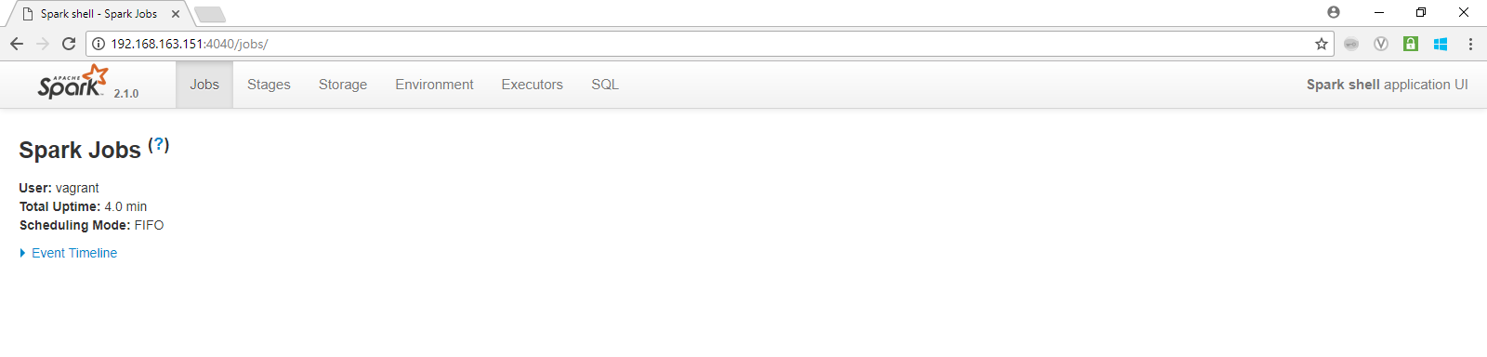
Architecture Overview - Role of Driver
Spark shell application UI.
Notes:
https://hostIp:4040
The Web UI is application specific.

Slide 7
Architecture Overview - Role of Executors
Distributed agent.
Responsible for:
Executing tasks.
Performing data processing.
Reading from and Writing data to external sources.
Storing computation results data in-memory, cache or disk.
Interacting with the storage systems.

Slide 8
Architecture Overview - Role of Cluster Manager
It is an external service.
Responsible for:
acquiring resources and allocating them to a spark application.
allocation and deallocation of various physical resources such as CPU, memory, etc..,

Slide 9
Architecture Overview - Role of Cluster Manager
Three types of cluster managers:
Standalone Cluster Manager
Hadoop YARN
Apache Mesos
Spark
Spark
Spark
YARN
MESOS
Local FS / HDFS / other storage system
Local FS / HDFS/ other storage system
Local FS / HDFS/ other storage system
Standalone Hadoop YARN Apache Mesos

Slide 10
Spark Cluster Setup
Pseudo distributed mode cluster setup

Slide 11
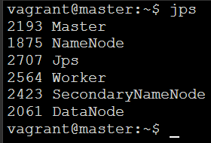
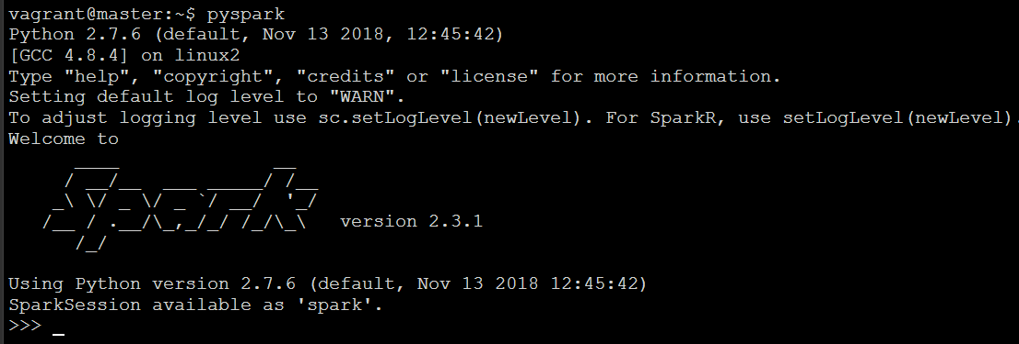
Spark Shell
Provides interactive shell for data exploration and testing (REPL).
To start Spark Shell, type spark-shell command as shown below.
Note: REPL (Read/Evaluate/Print Loop)

Slide 12
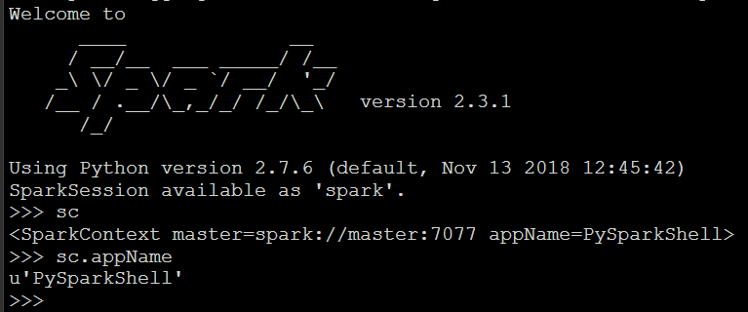
Spark Context
At high level, every Spark application requires Spark Context.
Spark Context is entry point to the Spark API.
Driver program communicates with Spark through Spark Context.

Slide 13
Questions
Notes:
Application Delivery Fundamentals (ADF) 2.0: Testing
Module 02: Introduction to Software Development Life Cycle (SDLC)

Slide 14
Thank You

